Slide 1

Internet of Things Empowered Smart Greenhouse Farming
Under the guidance of
Smt U.N.Subhadra Devi
M.Tech,(Ph.D) ,Assistant Professor ,ECE
Under the guidance of
MVGR COLLEGE OF ENGINEERING (A), VIZIANAGARAM
IV Year B. Tech.
Electronics and Communication
V. Teja T. Tejo Venkatesh R. Jai Chandra
19335A0415 18331A04F6 18331A04C3

Slide 2
Contents
Abstract
2. System Overview
3. Hardware requirements
a.)Sensors
b.)Actuators
4. Working Of Sensors
5. Features Of ATmega328
6.ESP8266 Commands
7. Aurdino code
8. Things Speak Cloud
9. Expected Results
10.Things Speak Outputs
11.Results
12.Advantages
13.Reference Papers and Websites
14.Limitations and Conclusion

Slide 3
Abstract
The rapid change of climate, population explosion, and reduction of arable lands are calling for new approaches to ensure sustainable agriculture and food supply for the future. Greenhouse agriculture is considered to be a viable alternative and sustainable solution, which can combat the future food crisis by controlling the local environment and growing crops all year round, even in harsh outdoor conditions. However, greenhouse farms persist many challenges for efficient operation and management. The evolving Internet of Things (IoT) technologies, which encompass the smart sensors, devices, network topologies, big data analytics, and intelligent decision is believed to be the solution in addressing the key challenges facing the greenhouse farming, such as greenhouse local climate control, crop growth monitoring, crop harvesting and etc.
This work is primarily about the improvement of current agricultural practices by using modern technologies for better yield. This work provides a model of a smart greenhouse, which helps the farmers to carry out the work in a farm automatically without the use of much manual inspection. Greenhouse, being a closed structure protects the plants from extreme weather conditions namely: wind, hailstorm, ultraviolet radiations, and insect and pest attacks. In our project here we are using THINGS SPEAK CLOUD platform to monitor the growth of the plants.

Slide 4
Introduction
Greenhouses are the controlled environments where the plants are grown.
to Greenhouse is s structural building with different types of covering material with a glass or a plastic roof artificially create a greenhouse effect.
Greenhouse Automation System is the technical approach in which the farmers in the rural areas will be benefited by automatic monitoring and control of greenhouse environment. It replaces the direct supervision of the human.
we can control and monitor the multiple Greenhouses using IOT from the central location .

Slide 5
Why and how?
Greenhouse form an important part of agriculture and horticulture, which are one of the primary sectors of our country
They can be used to grow plants under controlled climatic conditions for optimal production .
This involves automatic governing and controlling of climatic parameters and hence thereby controlling and continuously monitoring the growth of a plant
To monitor the growth of the plant autonomously we need to use some software developed tools such as aurdino, sensors etc…

Slide 6
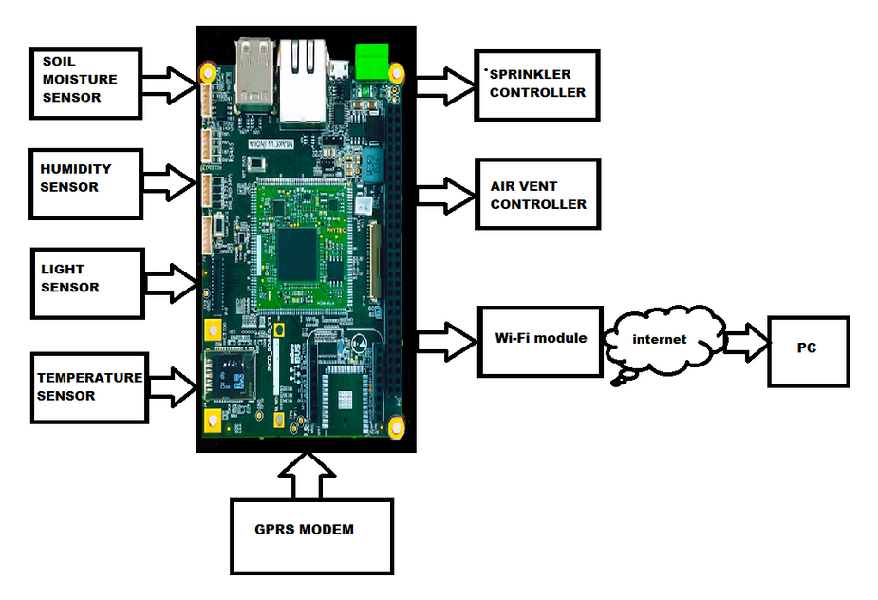

Slide 7
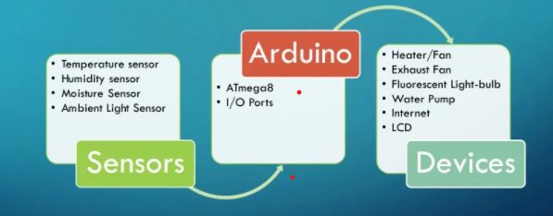
System Overview
Voltage output from sensors will be sent as inputs into the Arduino.
based on the input values arduino output specifies the voltage to turn on or off the device based on the requirement

Slide 8
Hardware requirements
a.)Sensors
1.ambient light sensor
2.temperature sensor
3.humidity sensor
4.moisture sensor
b.) power supply circuit
c.) Microcontroller
d.)Actuators
1.cooling fan
2.CFL bulb
3.water pump
e.)Ethernet shield
f.)LCD display

Slide 9
Working of sensors
Moisture sensor:
Soil moisture sensor will check the water present in the soil.
If there is no proper water in the soil, the moisture sensor sends signal to the water pump as a result of which the pump gets activated and pump the water from the tank into the soil.
With help of a threshold value of the water level present in the soil the pump is automatically turned off.
Humidity sensor:
Humidity sensor is used to check the humidity of the air in the greenhouse.
If humidity exceeds the limit then an exhaust fan will switch on with the help of a relay to throw the humid air out of the greenhouse to maintain a suitable environment for the plants.

Slide 10
Working of sensors
Temperature sensor :
If the temperature exceeds beyond the limit set then a fan will be automatically switched on as a coolant to reduce the temperature.
When it reaches the desired temperature the fan will be switched off automatically with the help of a relay.
Light sensor :
Light sensor will send the light and set an optimum temperature in the greenhouse for the plants.
An artificial light will be switched on automatically by the light sensor with the help of an relay and also switched off automatically.
the light sensor is involved to resemble the action of sunlight

Slide 11
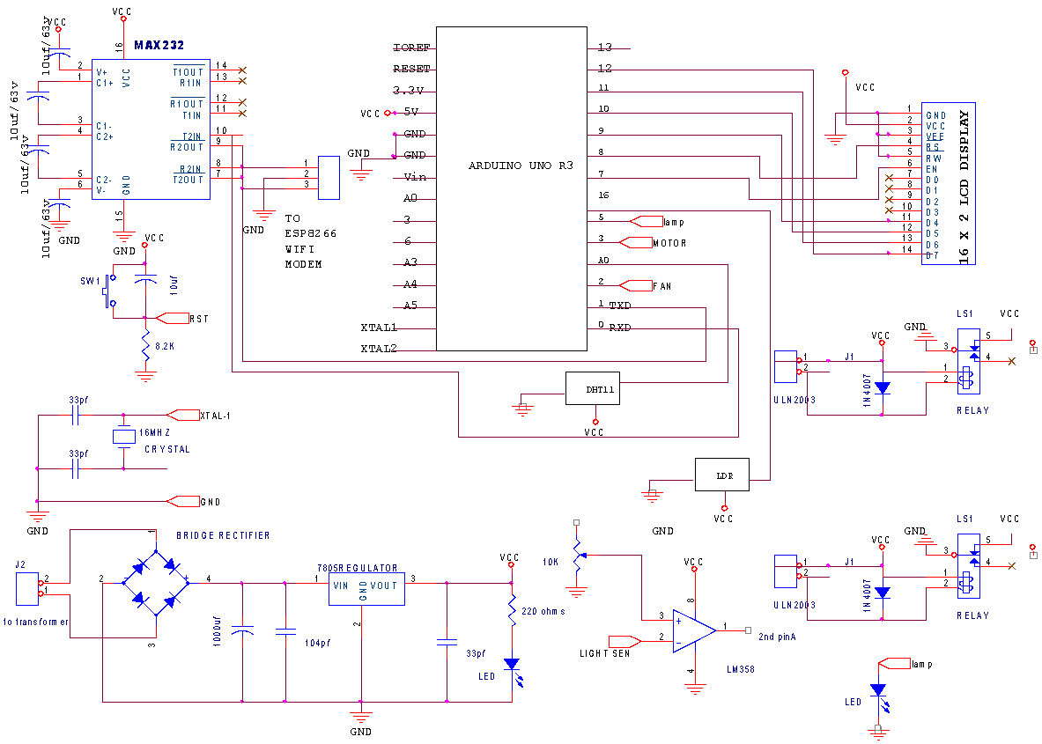

Slide 12
Features of ATMega328:
Microcontroller can be described as a computer embedded on a rather small circuit board. To describe the function of a microcontroller more precisely, it is a single chip that can perform various calculations and tasks, and send/receive signals from other devices via the available pins. Precisely what tasks and communication with the world it does, is what is governed by what instructions we give to the Microcontroller. It is this job of telling the chip what to do, is what we refer to as programming on it.
However, the uC by itself cannot accomplish much; it needs several external inputs: power, for one; a steady clock signal, for another. Also, the job of programming it has to be accomplished by an external circuit. So typically, a uC is used along with a circuit which provides these things to it; this combination is called a microcontroller board. The Arduino Uno that you have received is one such microcontroller board. The actual microcontroller at its heart is the chip called Atmega328. The advantages that Arduino offers over other microcontroller boards are largely in terms of reliability of the circuit hardware as well as the ease of programming and using it.

Slide 13
Commands for using ESP8266
Ensure AT commands are received correctly (the AT seems not to be case sensitive but the rest of any command is case sensitive):
AT Response:
OK
2. Ensure the module is in a known state by issuing a reset command:
Using GNU Screen
First Commands AT+RST
3. Check the firmware version:
AT+GMR
The stock firmware produces this output: 00160901
4. Enable the module to act as both a “Station” and an “Access Point”:
AT+CWMODE=3
Response: OK
5. List surrounding WiFi networks
6. Join a suitable WiFi access point:
AT+CWJAP="",""
You should get an OK response

Slide 14
DHT.read11(dht_dpin);
lcd.clear();
lcd.setCursor(0,0);
lcd.print("H=");
lcd.print(humidity=DHT.humidity);
lcd.print("%");
lcd.setCursor(6,0);
lcd.print("T=");
lcd.print(temperature=DHT.temperature);
// lcd.write(1);
//lcd.print("C");
delay(100);
//val = analogRead(1);float T=( val/1024.0)*5000; TEMP= T/10;
//lcd.setCursor(0,0);lcd.print("TEMP:");lcd.setCursor(6,0);lcd.print(TEMP);delay(50);
/* gas = analogRead(0); TEMP1=( gas/1024.0)*5000;
lcd.setCursor(11,0);lcd.print("G=");//lcd.setCursor(6,1);
lcd.print(TEMP1);delay(50);*/
if(digitalRead(soil) == 0)
{
lcd.setCursor(0, 1);lcd.print("WET LAND");
ecg = 1;
upload = 1;
}
else
{
ecg = 0;
}
delay(500);
upload = 1;
}
if(digitalRead(light) == 0)
{
lcd.setCursor(0, 1);lcd.print("LIGHT DETECTED");
fire1 = 1;
upload = 1;
}
else
{
fire1 = 0;
}
count++;
if(upload == 1||count == 2)
{
count =0;
upload = 0;
upload1();
Serial.print("AT+CWJAP=\"");
Serial.print(ssid);
Serial.print("\",\"");
Serial.print(password);
Serial.println("\"");
if(check((char*)"OK",300))

Slide 15
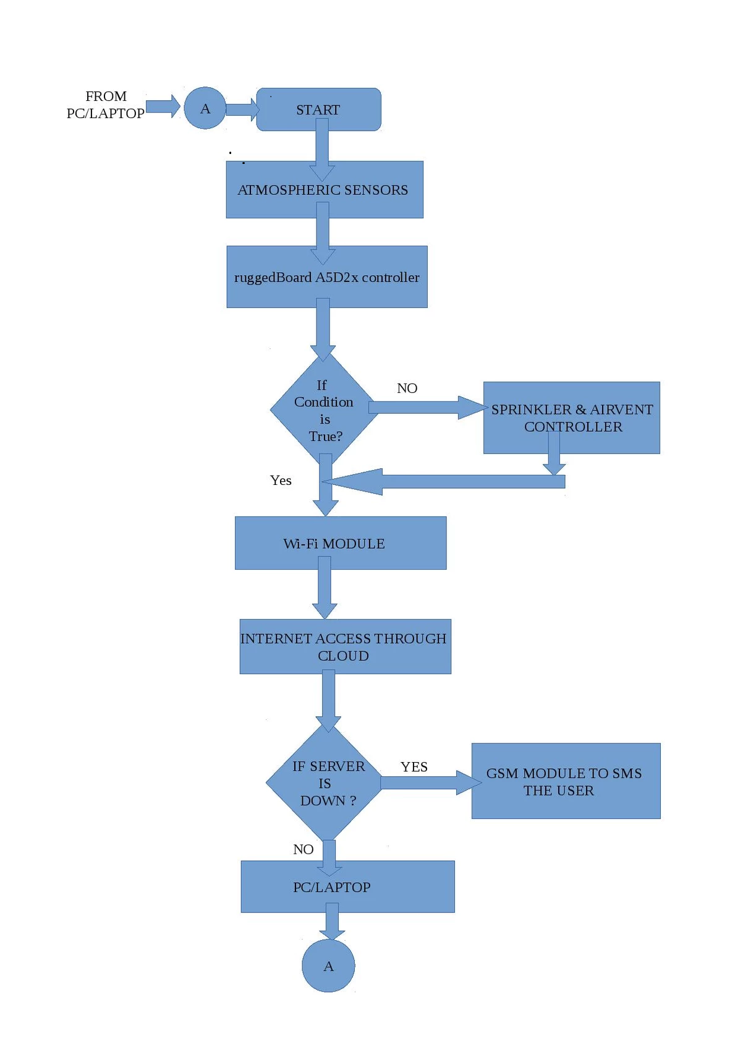

Slide 16
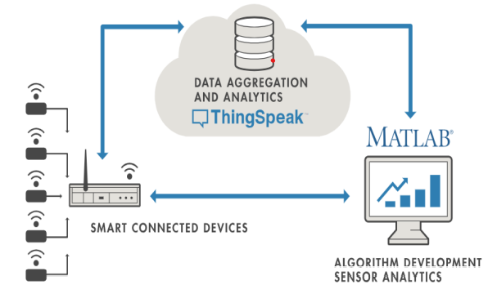
Thingspeak

Slide 17
Thingspeak cloud
Thingspeak is an Internet of Things (IoT) platform that lets you collect and store sensor data in the cloud and develop IoT applications.
Thingspeak IoT platform provides apps that let you analyse and visualise your data in matlab , and then act on the data.
The connected devices communicate with people and other things and often provide sensor data do cloud storage and cloud computing resources when the data is processed and analysed to gain important insights cheap cloud computing power and increased device connectivity is enabling this trend
How the device works?
On the left we have smart devices that leave at the edge of the network these include sensors which collect data.
In the middle we have the cloud where the data from many sources is aggregated analyst in real time often by IoT analytics platform designed for this purpose.
The right side of the diagram depicts the algorithm development associated with the IoT application this IoT system includes this elements.

Slide 18
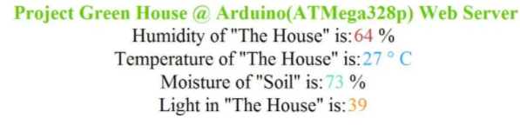
Expected result
Temperature, heat, moisture and light sensors are the four main sensors used in the project which give the exact value of temperature, heat, moisture and light respectively.
The sensors give the correct information according to the plants condition.
The result is displayed on the LCD screen present on the project end an Internet website.

Slide 19
Thingspeak outputs: graphical plots of four parameters 1.Light 2.Temperature 3.moisture 4.Humidity finally updated on MAY27th

Slide 20
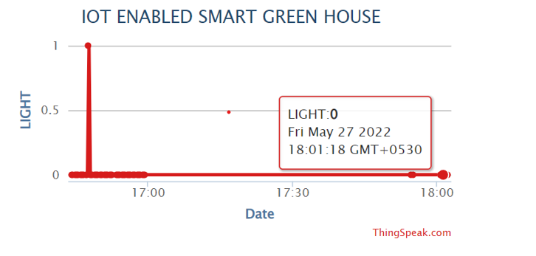
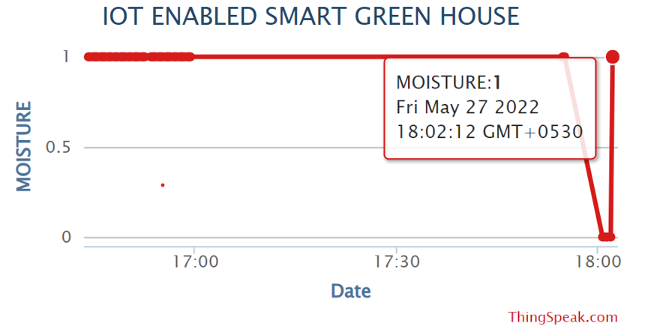
RESULTS
FROM THINGSPEAK

Slide 21
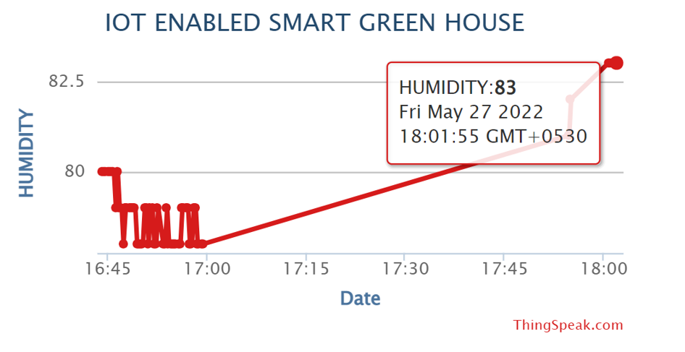
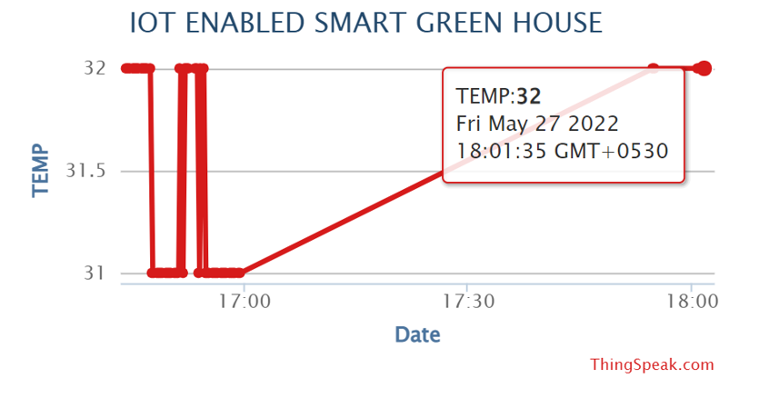

Slide 22
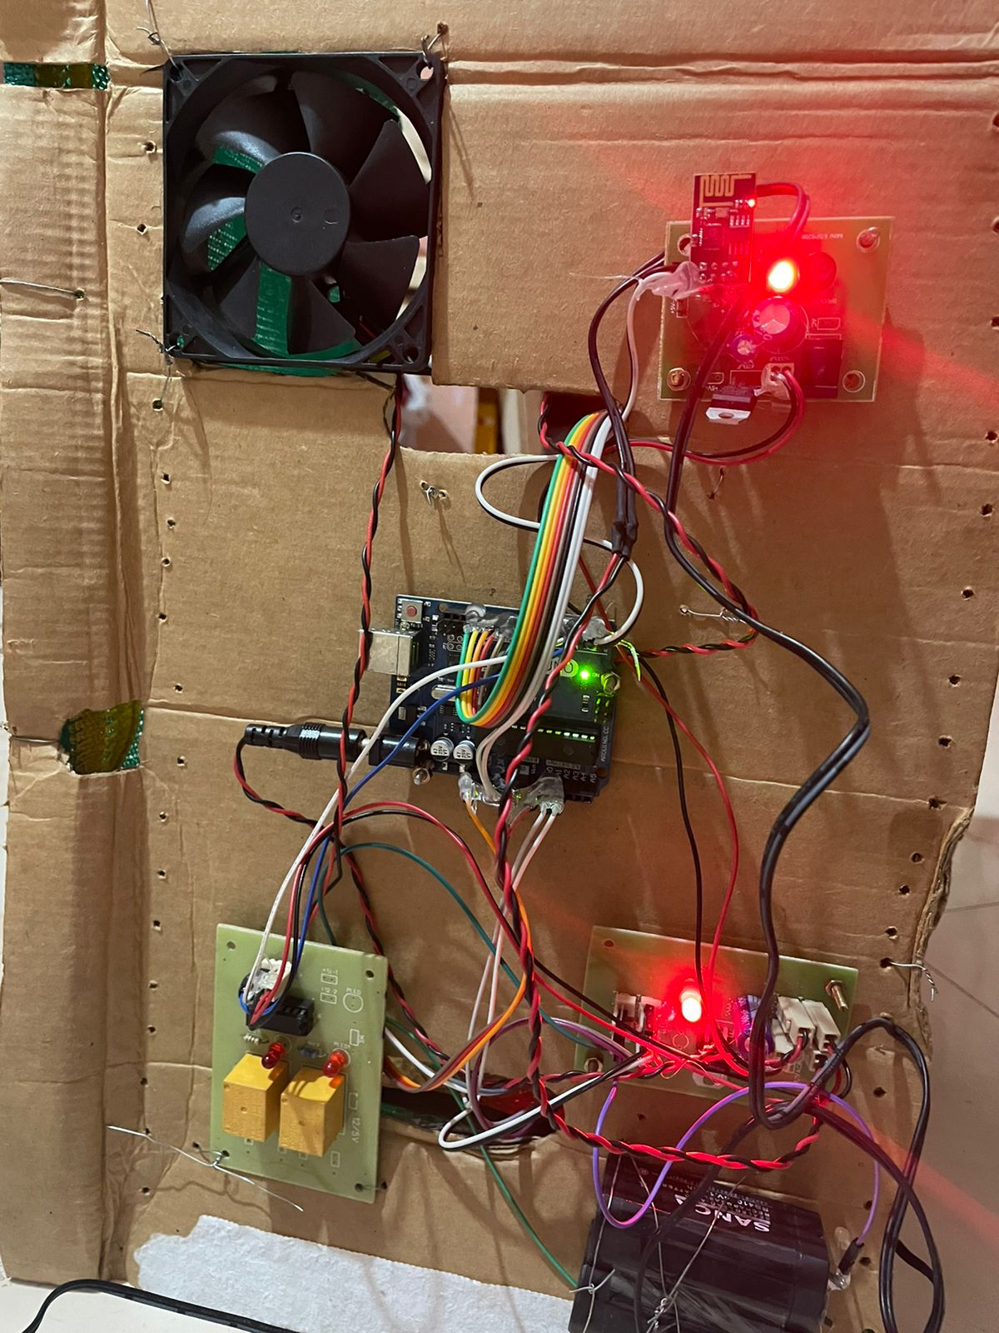

Slide 23
FUTURE SCOPE
Equipped with modern sensor and communications technologies, smart greenhouses automatically capture and deliver information 24/7 on the surroundings and crop. Collected data is fed into an IoT platform where analytical algorithms turn it into actionable intelligence to uncover bottlenecks and abnormalities. Accordingly, HVAC and lighting operations, alongside irrigation and spraying activities can be regulated on-demand. Continuous data monitoring facilitates the development of predictive models to assess crop disease and infection risks.
By unlocking massive crop insights, a smart greenhouse allows growers to minimize labor work, improve efficiency in resource and chemical use while optimizing yield rates.
The future or the enhanced version is developed using more advanced sensors and AI and machine learning algorithms . The aim for designing AI-based automation systems in greenhouse environments such as those that operate with fuzzy logic or neural network algorithms is to shift toward a robust, predictive, and adaptive control command strategies that reduce production costs and improve yield. Artificial intelligence is a computer system that is programmed to present intelligent behavior by perceiving the environment, making decisions, and taking action. AI can contribute to sustainable greenhouse production in different ways such as reducing the electrical energy consumption of the climate control systems, or reducing water and chemical demands for fertigation system.

Slide 24
Advantages
Cost Management and Waste Reduction: Mitigating risk is probably the best intervention that IoT can offer for the agriculture industry. If we can detect inconsistencies and anomalies in crop production, we will be able to control costs and reduce waste to increase production.
Process Automation: We can get rid of the dependency of human labor to automate processes like irrigation, fertilizing, or pest control. IoT smart sensors and devices can maintain these processes through the product life cycle to increase production.
Precision Farming:Variable Rate Irrigation helps to optimize crop fields with improved yields and water efficiency. with precision farming, we can have more control over the farming practices and deliver quality products maintaining the highest standard as well.
Climate Condition Monitoring:With the connected application, you can gain hidden patterns and transform data into actionable insights to do more than just monitoring climate.
You can detect the common diseases for wheat, vine, and apple crops. To mitigate the risk of other diseases, you can check the historical trend of collected data as well.
Crop Management:Like the weather stations, we have already discussed that crop management tools are usually installed in the crop field to collect specific data.
Farmers can get important information with the help of IoT, such as temperature fluctuation and precipitation to leaf water.

Slide 25
References papers and websites
[1] Khan_2020_J._Phys._Commun._4_055008 reference 2016
[2] IoT based Smart Greenhouse Ravi Kishore Kodali, Vishal Jain and Sumit
Karagwal Department of Electronics and Communication Engineering National
Institute of Technology, Warangal
[3] https://www.slideshare.net/AmitSaini7/arduino-based-intelligent-greenhouse-
Project
[4] https://www.slideshare.net/zaynssetiawam/green-house-monitoring-system-based-
on-arduino-uno
[5] https://www.community.ruggedboard.com/post/iot-smart-agriculture
[6] Internet of Things Empowered Smart Greenhouse Farming Rakiba Rayhana,
Student Member, IEEE,
[7] Dr. Narayan G. Hegde, “Water Scarcity and Security in India”, BAIF Development
Research Foundation, Pune.
[8] Marvin T. Batte, “Changing computer use in agriculture: evidence from Ohio”,
Computers and Electronics in Agriculture, Elsevier science publishers, vol. 47, 1–
13, 2005

Slide 26
Limitations of the project:
Suitable for only limited variety of crops
Economical only when implemented only on large scale
Takes time for ROI
Disability of recognising pests
Conclusion:
The monitoring & controlling system of the Smart Greenhouse Automation precepts different parameters inside the greenhouse using sensors, GSM & IOT to provide the updates. The developed system can be proved profitable as it will optimize the resources in the greenhouse. The complete module is of low cost, low power operation hence, easily available to everyone.

Slide 27


